Slide 1
Interface
Interface is the path for communication between two components.
Interfacing is of two types
a)memory interfacing
b)I/O interfacing.

Slide 2
Memory Interfacing
When we are executing any instruction, we need the microprocessor to access the memory for reading instruction codes and the data stored in the memory. For this, both the memory and the microprocessor requires some signals to read from and write to registers.

Slide 3
IO Interfacing
There are various communication devices like the keyboard, mouse, printer, etc. So, we need to interface the keyboard and other devices with the microprocessor by using latches and buffers. This type of interfacing is known as I/O interfacing.

Slide 4
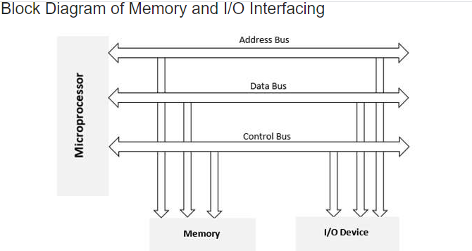

Slide 5
8085 Interfacing Pins
A₁₅ - A₈ (Higher Address Bus)
AD₇ - AD₀(Lower Address/Data Bus)
ALE
RD
WR
READY

